Slide 1
Lecture 24 – Control and data hazard mitigation
2017.10.18
John Anderton: Why'd you catch that?
Danny Witwer: Because it was going to fall.
John Anderton: You're certain?
Danny Witwer: Yeah.
– from the movie Minority Report

Slide 2
Announcements
Midterm 2 covers
Lectures through Oct. 23
Labs 01 to 05
Homework 01 to 07
Text chapters 1 to 9
Emphasis is on material covered Sep. 18 to Oct. 23
HW 07 issues Oct. 20
Midterm 2 practice exam soon, new format
Midterm 1 practice exam (HW04) will score as 15 (maximum HW score) for all submitted

Slide 3
Control hazards in a pipeline
Control hazard – hardware will fetch before the next_instruction_address is certain
Cause in pipeline: branch instructions
Actual sequence of executed instructions is called the program instruction execution trace
Branch instructions mean instruction execution trace need not be a linear; further, trace may be unknowable until run time
How to cope with control hazards? Many different designs have been tried to cope with control hazard stalls

Slide 4
Conservative solution to control hazard – stall
Stall – just wait to fetch until next_instruction_address is known for sure; called resolving the branch
Reduce wait by reducing duration of stall
Reduce time to resolve MIPS instruction beq $3, $4, 20 (branch if equal)
Add circuitry to the ID stage to compare registers and compute branch target address (resolve), then update PC
Actual next_instruction_address now known in ID stage rather than waiting until EX state: 1 clock cycle sooner
Still, IF stage will fetch at default_next after the branch instruction is fetched, even when branch is ultimately taken
Many ISA or pipeline designs cannot resolve by ID stage

Slide 5
Example: stalling when branch resolves in ID stage
Instr. No. | Clock cycle | 1 | 2 | 3 | 4 | 5 | 6 | 7 | 8
1 | add $4,$5,$6 | IF | ID | EX | MEM | WB
2 | beq $1,$2,40 |  | IF | ID | EX | MEM | WB
3 | lw $3,300($0) |  |  | NOP | IF | ID | EX | MEM | WB
Decoding of the branch in ID causes NOP substitution in IF followed by known-correct fetch by IF
If branch is not taken then a good fetch has been thrown away
Correct result is achieved directly

Slide 6
“There is a difference between knowing the path and walking the path.” Morpheus, THE MATRIX
Stalling will increase program run time
Waiting for certainty has a co$t
It may cost less to walk the path before knowing it – to predict the next instruction –and then fetch speculatively
Notes:
You can walk the path before you know the path.
Speculative fetch can obtain the correct instructions before it is certain that they are the correct instructions to execute.

Slide 7
Control hazard solution – Predict next instr.
Literally, guess the next_instruction_address
Does not stall pipeline when guess is correct
When incorrect, must (1) nullify instructions that were incorrectly fetched and (2) fetch correctly
Prediction has a payoff in units of time saved
Positive payoff when correct; negative when incorrect
Positive/negative payoffs need not be symmetric
How does hardware predict branch direction?
Many different ways, from fixed prediction to hardware-based AI guessing

Slide 8
Predict branch not taken
Predict not taken is exactly the same as “Just keep fetching, just keep fetching”
at default_next_instruction location
If branch is not taken then pipeline proceeds at full speed
Only when branch is taken does pipeline stall
🐟

Slide 9
Example: predict not taken; beq resolves in ID stage; beq target is PC+4+(4*offset)
Instr. No. | Clock cycle | 1 | 2 | 3 | 4 | 5 | 6 | 7 | 8
1 | add R4,R5,R6 | IF | ID | EX | MEM | WB
2 | beq R1,R2,40 |  | IF | ID | EX | MEM | WB
3 | lw R3,300(R0) |  |  | IF | ID | EX | MEM | WB
Above: predict not taken was correct; default fetch of lw correct
Below: prediction failed; NOP inserted in pipeline to replace lw
Instr. No. | Clock cycle | 1 | 2 | 3 | 4 | 5 | 6 | 7 | 8
1 | add R4,R5,R6 | IF | ID | EX | MEM | WB
2 | beq R1,R2,40 |  | IF | ID | EX | MEM | WB
3 | lw R3,300(R0) |  |  | IF | NOP | NOP | NOP | NOP
43 | or R7, R8, R9 |  |  |  | IF | ID | EX | MEM | WB
Wasted clock cycle

Slide 10
Predict branch is taken
Predict taken can be a good strategy for branches at the end of loop constructs
Might predict branches with a negative offset field value are always taken
Mispredict only on final iteration
Fixed prediction is, however, a rigid approach, relying on stereotypical branch behavior
What might be better?

Slide 11
Branch fall through, target, and delay slot
When branch not taken, next instruction is from the fall through location
When branch is taken, next instruction is from the branch target location
Instruction fetch cycles occurring after the branch instruction fetch and before the branch resolves are called the branch delay slot
What instructions would we most like to fetch while waiting for a branch to resolve?

Slide 12
Code rescheduling applied to branch hazards
Code rescheduling: change the default order of machine instructions to have fewer pipeline stalls but without changing the meaning of the program
Strategy: apply code scheduling and hardware design, in combination, to make productive use of the time between fetching a branch instruction and when the branch is resolved
Technique is called delayed branch instruction

Slide 13
Delayed branch implementation
Assume that the pipeline design will fetch K instructions before a branch instruction resolves, then because instructions from before a branch must execute regardless of how the branch resolves
Look for up to K instructions from before the branch that, crucially, the branch does not depend on for the information that controls the branch decision
Place these J≤K instructions followed by K-J NOPs after the branch inside the branch delay slot locations in instruction memory
These J instructions and the K-J NOPs will be fetched by default and J of them are guaranteed to be useful
Hardware must now be designed to NOT replace J instructions with NOP in the event the branch is taken
Compilers can usually fill ~50% of branch delay slot
Fill is less than 100% because of dependence of branch on preceding instructions

Slide 14
Example: delayed branch; beq target is PC+4+(4*offset)
Instr. No. | Clock cycle | 1 | 2 | 3 | 4 | 5 | 6 | 7 | 8
1 | add R4,R5,R6 | IF | ID | EX | MEM | WB
2 | beq R1,R2,40 |  | IF | ID | EX | MEM | WB
3 | lw R3,300(R0) |  |  | IF | ID | EX | MEM | WB
Above: original code sequence; no dependence from add to beq
Below: Rescheduled instruction sequence: add fills beq delay slot;
IF fetches the rescheduled add, then fetches based on resolved beq
Instr. No. | Clock cycle | 1 | 2 | 3 | 4 | 5 | 6 | 7 | 8
1 | beq R1,R2,41 | IF | ID | EX | MEM | WB
2 | add R4,R5,R6 |  | IF | ID | EX | MEM | WB
–– 3 \ ⁴³ | lw R3,300(R0) or R7,R8,R9 |  |  | –– IF \ IF | ID ID | EX EX | MEM MEM | WB WB
If beq not taken, fetch lw at PC+4, else fetch or at PC+4+(4*41) = PC+164₁₀ = 42 instrs. beyond beq. Rescheduling changes offset.

Slide 15
Speculative filling of branch delay slot
Delay slot can be filled with certainty by
NOP instructions, which is slow and always correct
Independent instructions from before the branch plus NOPs, which reduces execution time and is always correct
If certainty not possible, then can speculate (predict) by filling from a possible execution path after branch
If predict branch not taken, then should schedule from fall through path (the not-taken path)
If branch is taken, then the instruction(s) speculatively placed in delay slot will be executed and, thus, must have been vetted to not cause program to be incorrect if branch is not taken
If predict taken, then schedule from target (the taken path)
Again, instruction(s) speculatively placed in delay slot must not cause program to be incorrect if branch not taken

Slide 16
Scheduling a branch delay slot, 3 cases
From before |  | From target |  | From fall through
add $1, $2, $3 |  | sub $4, $5, $6 |  | add $1, $2, $3
If $2 = 0 then |  | … |  | If $1 = 0 then
Delay slot |  | add $1, $2, $3 |  | Delay slot
… |  | If $1 = 0 then |  | sub $4, $5, $6
Target |  | Delay slot |  | ...
Becomes |  | Becomes |  | Becomes
 |  | sub $4, $5, $6 * |  | add $1, $2, $3
If $2 = 0 then |  | … |  | If $1 = 0 then
add $1, $2, $3 |  | add $1, $2, $3 |  | sub $4, $5, $6
… |  | If $1 = 0 then |  | …
Target |  | sub $4, $5, $6 *
add instr. is moved, or scheduled, into delay slot
* sub must be copied when it can be reached by an execution path not containing this branch
sub instr. is placed in delay slot by the compiler, same as other two cases

Slide 17
Delayed branch limitations
Limitations are
Instruction(s) in the delay slot WILL be executed and NOT nullified, so execution must be OK even if scheduled from the dynamically wrong execution path
Cannot violate dependences when moving instructions to fill the delay slot
Inability to predict at compile time whether a branch is likely taken or not to inform scheduling decision
More pipeline stages means faster clock rate (good for performance) but typically means longer branch delay slots, and longer slots are harder to fill usefully (bad for performance)

Slide 18
Predict based on branch history
Dynamic branch prediction – each time a given branch instr. is executed, use the branch resolution – taken or not taken – to inform (update) the prediction for that branch instr.
Example: a 1-bit predictor (has 1 bit of history of prediction)
State diagram of 1-bit predictor:
1-bit predictor strategy: If mispredict, change prediction
State
State transition, labeled by causal condition
Branch is taken
Branch is not taken
Branch is not taken
Predict branch will be taken
Predict branch will not be taken
Branch is taken

Slide 19
Is 1 bit able to improve performance?
Dynamic prediction using just 1 bit of memory per each branch instruction can often achieve 90+% correct guessing*
Past performance is not a guarantee of future results. Your program’s mileage may vary. Limited by available branch history memory. Better performance available with optional 2-bit history memory at higher cost.

Slide 20
Implementation and operation
Database in hardware (fast) records info for N most recently executed branch instructions
When a branch instruction is detected, look up its prediction in table and fetch at predicted next_instruction_address ∈{default, target}
How should we index this table of predictions?
By instr. address
Address of this branch instruction | Prediction for this branch instruction
0x00403560 | Taken
0x00403584 | Not taken
… | …

Slide 21
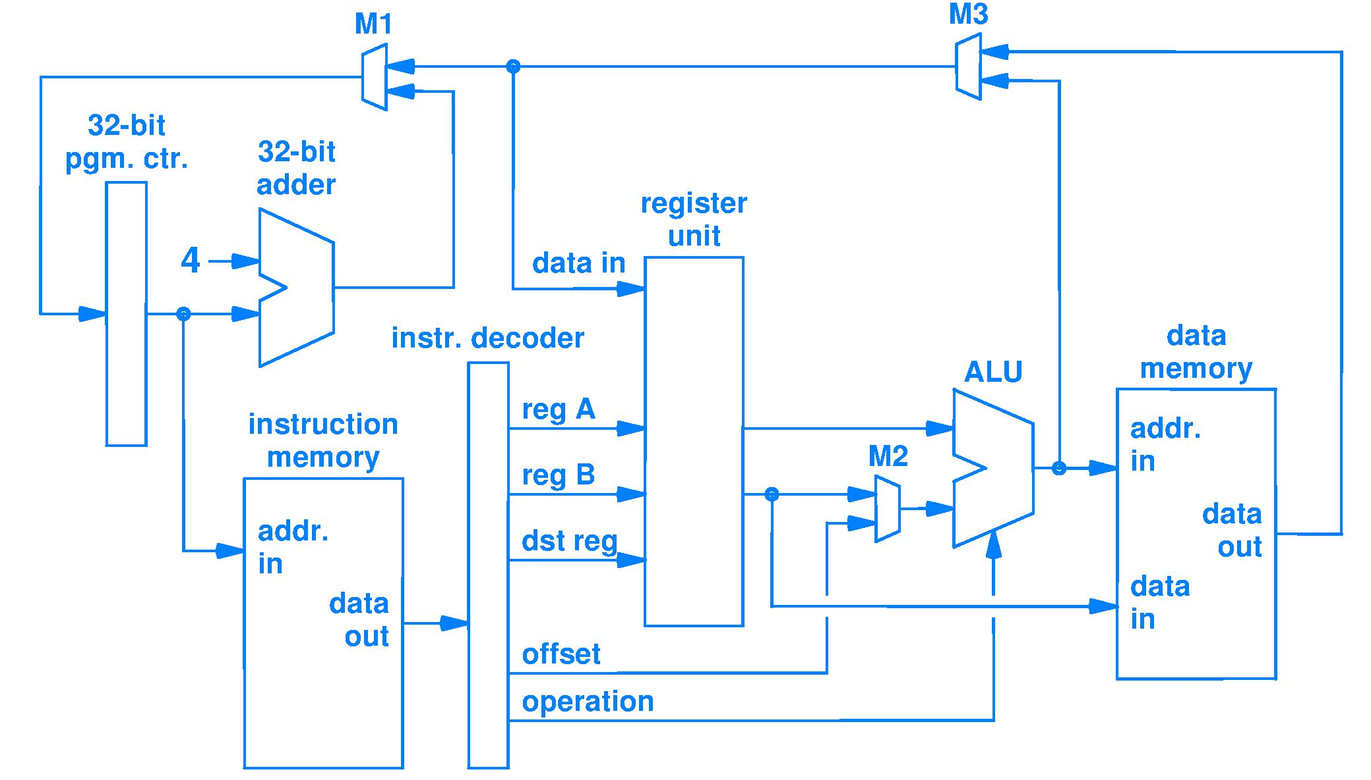
How soon can a branch instruction be detected in the circuit of Fig. 6.9?
To answer well, we need to establish the precise scenario of the question and the requirements for an answer
Scenario
circuit of Fig. 6.9
and an executing program
Requirements for an answer
distinguish branch instructions from all other instructions and from program data
What, exactly, is a branch instruction?
A bit string that, when interpreted according to the instruction format, has a certain opcode
Thus, an answer to “how soon to detect?” is As soon as an instruction is decoded
circuit of Fig. 6.9
distinguish branch instructions from all other instructions and from program data

Slide 22
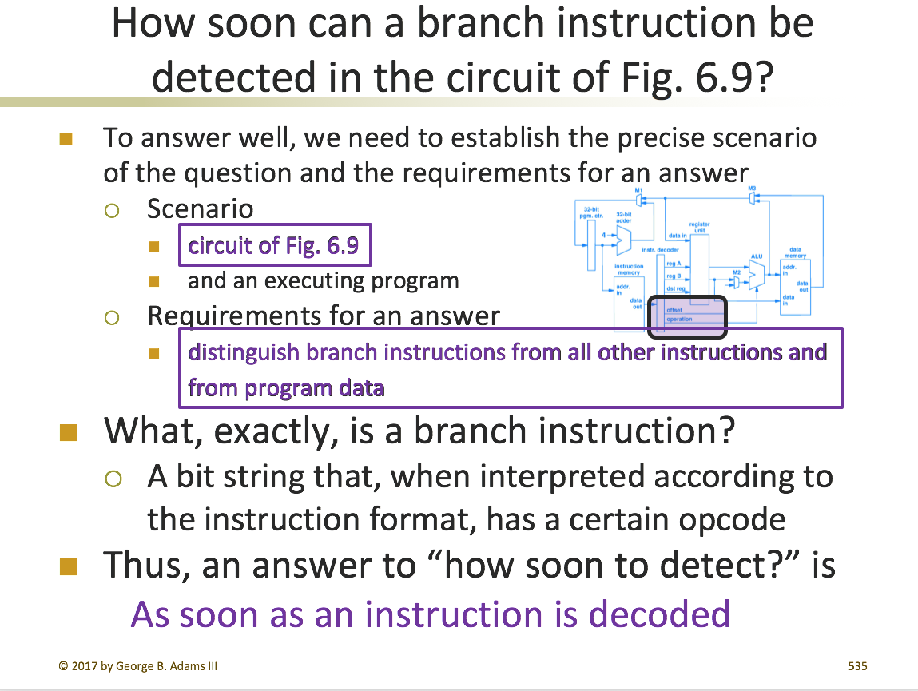
Might there be another answer?
First answer does not make use of all info

Slide 23
How make use of “executing program” info?
Example of an executing program (blue bits) 0x00400000 00010000111110010000000000010100 0x00400004 00010000100000011000000000011000 0x00400008 00001001000110100101010101010101
Examining program carefully reveals instrs. are
Unchanging bit strings (only read, never written)
Each at a fixed address (in instruction memory)
Conclusions
Record fetch addresses of decoded branch instrs., then in future can detect each branch based on fetch address alone, no need to wait to decode
Target address is constant; compute once, save, and look up in future; faster than re-computing

Slide 25
Branch prediction fast enough for zero stall
Every time a branch instr. is taken, have the processor record the address of the branch and its computed target address in a table that can be searched in fraction of a clock cycle. Fast hardware.
Branch instruction address | Branch target address (saved computed value)
0x00403560 | 0x00403568
0x00403584 | 0x0040359C
… | …
Locate branch prediction table hardware within IF stage
For each new PC fetch address, compare PC with all branch instr. addresses in the branch prediction table
If match, then branch detected (in IF stage, no decode)
If match, control mux M1 so as to make M1 output, a.k.a.,
Next_instruction_address = Branch_target_address
IF stage will fetch at Branch_target_address with next clock
Zero stall cycles

Slide 26
Future of branching
Delayed branch instructions losing popularity
Processor design trending toward pipelines with more stages and fetching multiple instructions per clock
Thus, branch delay slot harder to usefully fill
Delay slot not as valuable for keeping pipeline busy
Dynamic predictors increasingly popular
A hardware solution, so benefits from Moore’s Law
Does not require coordination by software

Slide 27
Data hazards in a pipeline
Data hazards occur when pipelining changes the order of read/write accesses to operands (data) from that of sequentially executing instructions on an non-pipelined processor
Instruction overlap is the cause of data hazards
Programs assume sequential semantics, violation of sequential meaning is an error

Slide 28
Dependence (*a.k.a. dependency)
Dependence is a property of a program whereby a fixed sequential relationship exists between actions of the code
Example code with a dependence
ADD R3, R4, R5 @ R3 ← R4 + R5
SUB R1, R3, R7 @ R1 ← R3 – R7
The dependence is that R3 must be computed by the ADD instruction before the SUB instruction may be allowed access to R3, else the SUB will use an incorrect Minuend value
Execution correctness requires that dependences not be violated, but sequencing may slow execution
* Dependence: from depend on Dependency: a province or country controlled by another

Slide 29
Reducing dependence-caused execution delay
Sometimes programs can be written differently to remove dependences
Sometimes one type of dependence can be exchanged for another that does not delay execution as much
Sometimes hardware design enhancements can reduce the delay of sequencing situations

Slide 30
Data dependence, a program property
Data dependence, or true data dependence: a value flows from one instruction to another
The flowing value is the result of one instruction that becomes an operand for a later instruction
Program correctness requires this flow
Flow occurs via a register or a memory location
Flow through a register is directly visible to the hardware because each register address is a static machine instruction field
Flow through a memory location cannot be determined from static information alone
100+R4 and 20+R6 may be identical addresses
20+R4 and 20+R4 may be different addresses if R4 changes between two instructions using 20+R4 as an address

Slide 31
Recall stalls from Fig. 5.5
ADD R1, R2, R3 ; R1 ← R2 + R3 , Instr. K SUB R4, R1, R5 ; R4 ← R1 – R5 , Instr. K+1
SUB must be stalled until ADD result is written to R1 so that R1 pointer field in SUB machine language instruction does not cause use of the result in R1 from an instruction earlier than the ADD
One data dependence coping strategy: stall when required

Slide 32
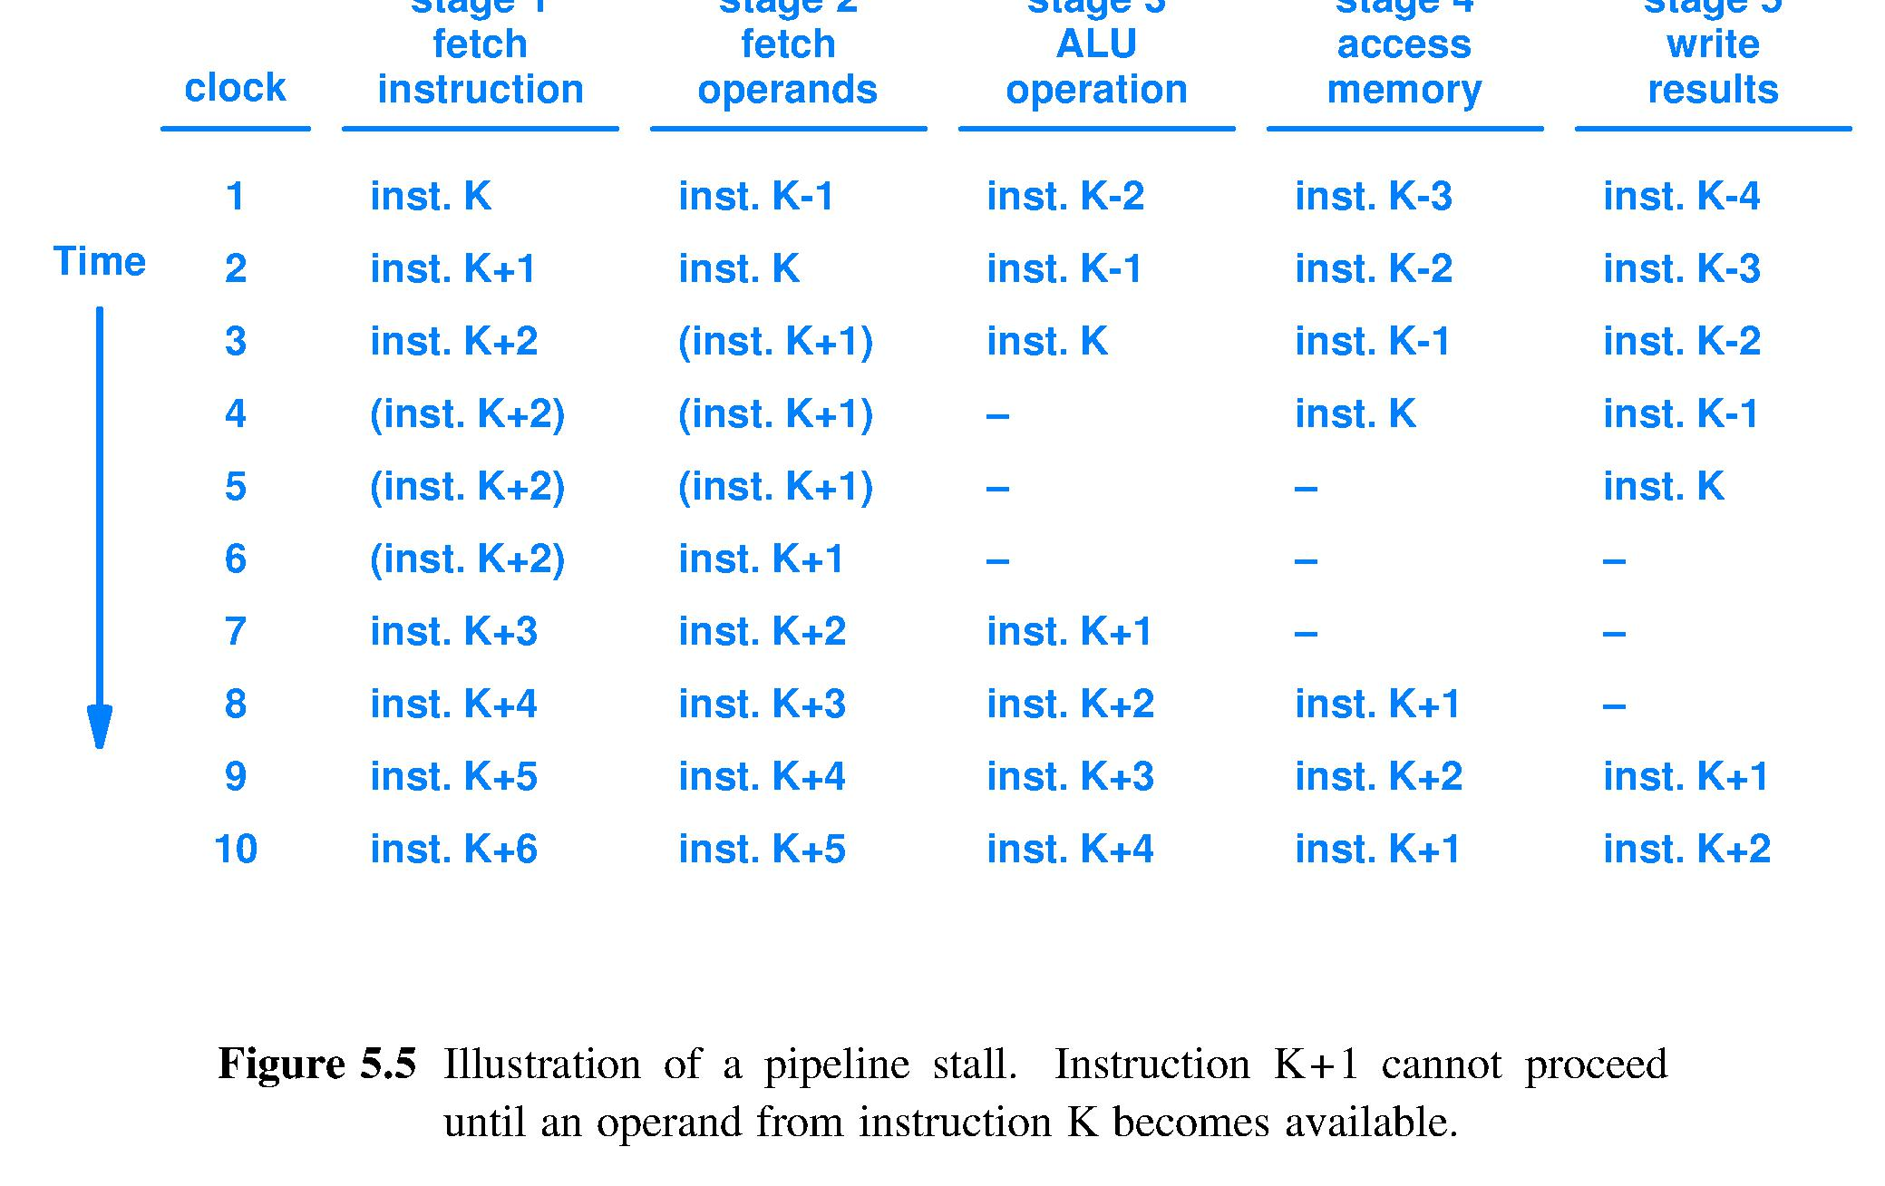
Inst. K+1 depends on K; stall until result written and detected (one of many design options)
NOP 1
NOP 2
NOP 1
NOP 2
NOP
NOP
NOP
NOP 3
NOP 1
NOP 3
NOP 2
NOP 3
Stalls/NOPs = 3 clocks wasted time = throughput loss
Textbook

Slide 33
Code snippet with 4 true dependences
ADD R1, R2, R3 @ R1 ← R2 + R3 SUB R4, R1, R5 @ R4 ← R1 – R5 AND R6, R1, R7 @ R6 ← R1 and R7 OR R8, R1, R9 @ R8 ← R1 or R9 XOR R10, R1, R11 @ R10 ← R1 xor R11
All instructions after the ADD use its result
How reduce stall cycles from text Fig. 5.5?
Registers are fast, so design for early write followed by late read during single clock cycle (do two register actions in one clock cycle)
Notes:
At 3 stall cycles per dependence this snippet of code will run quite slowly.
Finding a better way is becoming imperative.

Slide 34
Early write/late read diagram
Early write, late read allows result written early in clock cycle X to also be read as an operand late in clock cycle X
Read registers during second half of clock cycle
Write registers during first half of clock cycle
Instruction | Clock cycle 1 | CC 2 | CC 3 | CC 4 | CC 5 | CC 6
ADD R1, R2, R3 | Instr. Mem. | Read R2,R3 | ALU | Data Mem | Write R1
SUB R4, R1, R5 |  | Instr. Mem. | Read R1 | ALU | Data Mem | Write R4
AND R6, R1, R7 |  |  | Instr. Mem. | Read R1,R7 | ALU | Data Mem
OR R8, R1, R9 |  |  |  | Instr. Mem. | Read R1,R9 | ALU
XOR R10, R1, R11 |  |  |  |  | Instr. Mem. | Read R1,R11

Slide 35
Early write/late read saves 1 stall (green)
Time (in clock cycles)
Instruction | CC 1 | CC 2 | CC 3 | CC 4 | CC 5 | CC 6
ADD R1, R2, R3 | Instr. Mem. | Read R2, R3 | ALU | Data Mem | Write R1
SUB R4, R1, R5 |  | Instr. Mem. | Read R1 | ALU | Data Mem | Write R4
AND R6, R1, R7 |  |  | Instr. Mem. | Read R1, R7 | ALU | Data Mem
OR R8, R1, R9 |  |  |  | Instr. Mem. | Read R1, R9 | ALU
XOR R10, R1, R11 |  |  |  |  | Instr. Mem. | Read R1, R11
Program execution order (in instructions)
Result needed before it arrives at R1
R1 written in first half of cycle, can be read in second half; only 2-cycle delay until read
Result needed only after it arrives at R1

Slide 36
Reduce data register dependence stalls via software
Avoid stalls from value flows through registers
Stall happens because code says read an operand at a time when result is not yet in destination register
Assembly language instructions specify much smaller amount of computation than do most high level language statements
Often, there are several computationally equivalent variations for a given sequence of assembly language instructions
Software solution: Reschedule code , if possible, to read result later when it will be in the register unit

Slide 37
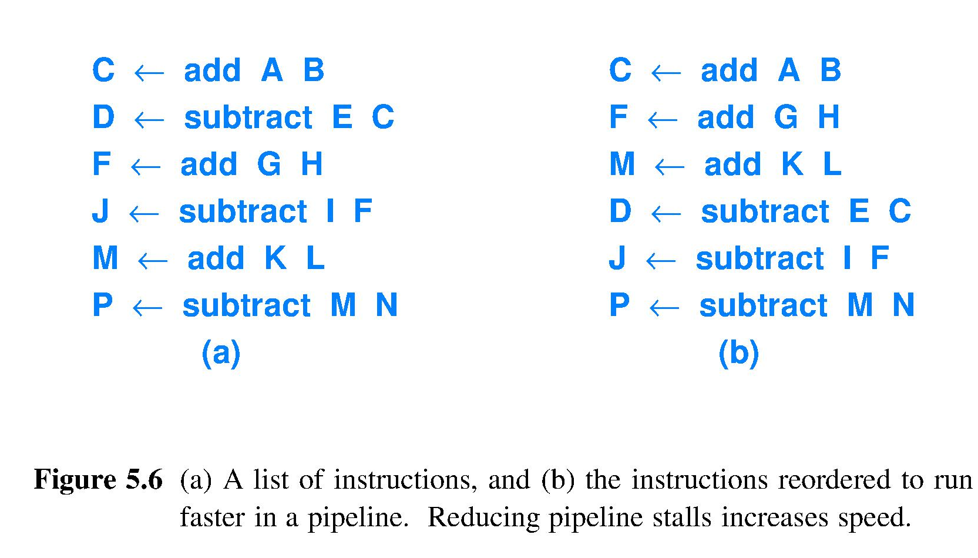
Another strategy: avoid stall situations
Have compiler optimize instruction order
Clock
Cycle
1
2
3
4
5
6
Rescheduled code
Need C, F, M one clock cycle after computation
Need C, F, M three clock cycles after computation

Slide 38
Reduce data dependence stalls via hardware
Again, avoid stalls from flow through register
Assembly code rescheduling may not be possible
Pipelined assembly program may ask in ID to “read before result has reached the register unit,” but no program says “read before the result exists”
If operand not yet in register unit, then it exists in the pipeline, moving towards the register unit
Hardware can added to allow operand source to be the pipeline itself; this is called forwarding
Strategy: Read an operand from wherever it is

Slide 39
Forwarding: Use R1 pointer to find ADD result value in pipeline stages; no stalls
Time (in clock cycles)
Instruction | CC 1 | CC 2 | CC 3 | CC 4 | CC 5 | CC 6
ADD R1, R2, R3 | Instr. Mem. | Read R2, R3 | ALU R1 | Data Mem ^{R1} | Write R1
SUB R4, R1, R5 |  | Instr. Mem. | Read R5 | ALU | Data Mem | Write R4
AND R6, R1, R7 |  |  | Instr. Mem. | Read R7 | ALU | Data Mem
OR R8, R1, R9 |  |  |  | Instr. Mem. | Read R1, R9 | ALU
XOR R10, R1, R11 |  |  |  |  | Instr. Mem. | Read R1,R11
Program execution order (in instructions)
Result obtained from within pipeline not Reg File via pointer “translation”
Result needed after it arrives at R1

Slide 40
To implement and operate forwarding
To all pipeline registers after ID stage add k+1 “label” bits
ID stage builds the label as follows
1 bit flag saying “instr. result goes to the register unit,” or Not
k bits to hold the pointer to the intended destination register (a copy of the destination field in the instruction itself)
Each following stage propagates this label without change
When label reaches WB stage
Store result in register unit, if flag says to, then destroy label
In the ID stage
Add logic and wires to match each operand pointer from the decoded instruction with every label in the pipeline
For every instruction passing through ID
If pointer/label match(es) found, then remap ALU operand physical source away from the register unit and to the next-clock-cycle location of the operand value in pipeline registers

Slide 41
Name dependence – dependence without value flow
Name dependence occurs when two instructions use the same register or memory location, called a name, but there is no flow of data between the instructions
Let instr. J precede instr. K in program order, then two kinds of name dependence
An anti-dependence between J and K occurs when K writes a register or memory location that J reads and instruction J is executed first
An output dependence occurs when J and K write the same register or memory location
Name dependence is a false dependence
Instructions involved in a name dependence can execute simultaneously or can be reordered, if the name is changed to remove the conflict

Slide 42
Example anti- and output dependences
ADD R1, R2, R4 ; R1 ← R2 + R4 SUB R4, R1, R5 ; R4 ← R1 – R5 AND R6, R1, R6 ; R6 ← R1 and R6 OR R8, R1, R9 ; R8 ← R1 or R9 XOR R6, R1, R11 ; R6 ← R1 xor R11
True dependences in orange
Anti-dependences in green
Output dependences in blue
AND R6, R1, R6 is not an anti-dependence because hardware enforces the read of R6 before the write to R6
R6 shows that one register may be involved in multiple kinds of dependences simultaneously

Slide 43
Parallelism and performance
Dependences represent enforced sequencing
Hardware performance higher when doing more work simultaneously
E.g., Add two 32-bit words in one step instead of adding two 1-bit bit positions repeated 32 times
When there is no dependence in a workload, then there is no inherent workload sequence
Freedom to execute in any order or, even better, simultaneously, is called parallelism

Slide 44
Instruction level parallelism (ILP)
Instruction level parallelism (ILP) is parallelism that exists in the assembly or machine code
Processor circuit can analyze machine instructions looking for ILP as a program runs
Must not change program sequential meaning when making use of ILP

Slide 45
Basic block – element of program structure
Basic block is an instruction sequence with
no branches in except to the first instruction of the block, the entry instruction, and
no branches out except at the exit branch
Basic blocks always execute from start to finish
Scheduling (reordering) instructions within a basic block cannot change program structure
Also, what does the IF stage do to fetch ALL of the instructions in a basic block?
Answer: Fetch the default_next_instruction, so fetch is fast and guaranteed correct

Slide 46
Exploiting ILP
For many programs, basic block length is short
Average dynamic frequency of branches (frequency along the program execution trace, as distinguished from the frequency of appearance in the static program text) is often between 10% and 20%
Meaning that on average only 4 to 9 instructions execute between a pair of branches
Thus, aggressively exploiting ILP requires looking across multiple basic blocks, but this means paying careful attention to program’s sequential semantics

Slide 47
Major ILP Techniques
Technique | Reduces
Forwarding and bypassing | Data hazard stalls
Delayed branches and simple branch scheduling | Control hazard stalls
Basic compiler pipeline scheduling | Data hazard stalls from true dependences
Dynamic scheduling by scoreboarding | Data hazard stalls from true dependences
Loop unrolling | Control hazard stalls
Branch prediction | Control hazard stalls
Dynamic scheduling with register renaming using Tomasulo approach | Data hazard stalls from output dependences and anti-dependences
Hardware speculation | Data hazard and control hazard stalls
Dynamic memory disambiguation | Data hazard stalls involving memory
Issuing multiple instructions per cycle | Ideal clock cycles per instruction (CPI)
Compiler dependence analysis, software pipelining, trace scheduling | Ideal CPI, data hazard stalls
Hardware support for compiler speculation | Ideal CPI, data hazard stalls, control hazard stalls

Slide 48
Example: Compiling to expose ILP
Look at how a compiler can increase the available ILP by transforming loops
Example, add a scalar to a vector: for (i=999; i>=0; i=i-1) { x[i] = x[i] + s; }
No loop iteration is dependent on another
Assume 64-bit floating point (FP) operands and the following inter-instruction latencies to avoid a pipeline stall

Slide 49
Assumed inter-operation latencies
Instruction producing result | Instruction using result | Latency in clock cycles
FP ALU op | Another FP ALU op | 3
FP ALU op | Store double | 2
Load double | FP ALU op | 1
Load double | Store double | 0
ADDI | BNE | 1
Latency = number of pipeline clock cycles that must separate producing instruction from using instruction

Slide 50
Assembly code for vector + scalar
LOADI R1, #999 ; R1 = 999
LOADI R2, #0 ; R2 = 0
Loop: LOAD.D F0, 0(R1) ; F0 = array element
ADDD F4, F0, F2 ; ADD double, F2=s
STOR.D F4, 0(R1) ; store result
ADDI R1,R1,–8 ; decrement pointer by 8
BNE R1,R2,Loop ; branch if R1!=R2
LOADI – load immediate value; R1 holds initial loop count to decrement, R2 holds iteration count bound
Now, show clock cycles where pipeline stalls

Slide 51
Code as written = 9 clock cycles/iteration
Clock cycle issued
(executing in EX stage)
Loop: LOAD.D F0,0(R1) 1
stall 2
ADD.D F4,F0,F2 3
stall 4
stall 5
STOR.D F4,0(R1) 6
ADDI R1,R1,–8 7
stall 8
BNE R1,R2,Loop 9
Source | Dest. | Ltncy.
FP ALU | FP ALU | 3
FP ALU | Store | 2
Load | FP ALU | 1
Load | Store | 0
ADDI | BNE | 1
Data dependence
Anti-dependence
Output dependence
(none in code)

Slide 52
Compiler schedules (re-orders) instructions, now code completes 1 iteration every 7 CC
 | ORIGINAL CODE | Issue CC |  | SCHEDULED CODE
Loop: | LOAD.D F0,0(R1) | 1 | Loop: | LOAD.D F0,0(R1)
 | stall | 2 |  | ADDI R1,R1,-8 | Scheduling ADDI here fills a stall cycle with work and eliminates a stall later
 | ADD.D F4,F0,F2 | 3 |  | ADD.D F4,F0,F2
 | stall | 4 |  | stall
 | stall | 5 |  | stall
 | STOR.D F4,0(R1) | 6 |  | STOR.D F4,8(R1) | Offset changed because of anti-dependence on ADDI R1,R1,-8
 | ADDI R1,R1,-8 | 7 |  | BNE R1,R2,Loop | R1 ready early for BNE
 | stall | 8
 | BNE R1,R2,Loop | 9
Scheduling ADDI
(Now no stall here)
Code now completes 1 iteration in 7 clock cycles instead of 9

Slide 53
More compiler optimization
Unroll loop – replicate the loop body to
Increase ratio of number of computation instructions to number of loop overhead instructions
Make basic block bigger increasing options for scheduling instructions into new sequences
To avoid introducing name dependences when unrolling, must use new register names for unrolled iterations
A larger register file has more names and thus better supports unrolling

Slide 54
Original loop text unrolled 4x, if R1-R2=0 mod 32
Loop: LOAD.D F0, 0(R1)
ADD.D F4, F0, F2 ; WILL STALL HERE, so remember to schedule
STOR.D F4, 0(R1) ; unroll; ADDI and BNE intentionally removed
LOAD.D F6, –8(R1) ; adjust offset to –8 ∵ removed ADDI
ADD.D F8, F6, F2 ; use F6, F8 to avoid output dependences
STOR.D F8, –8(R1) ; unroll; ADDI and BNE intentionally removed
LOAD.D F10, –16(R1) ; adjust offset to –16 ∵ again, removed ADDI
ADD.D F12, F10, F2 ; use F10, F12 to avoid output dependences
STOR.D F12, –16(R1) ; unroll; ADDI and BNE intentionally removed
LOAD.D F14, –24(R1) ; adjust offset to –24 ∵ again, removed ADDI
ADD.D F16, F14, F2 ; use F14, F16 to avoid output dependences
STOR.D F16, –24(R1) ; end of 4th loop body
ADDI R1,R1,–32 ; decrement pointer by 32 ∵ 4 loop bodies
BNE R1,R2,Loop ; test and branch if another iteration needed
Non-trivial optimization requiring symbolic substitution and simplification
Eliminates 3 branches and 3 decrements of R1 ← Saves 6 instructions
Also, basic block also now large enough to schedule with zero stalls

Slide 55
4x unrolled loop after scheduling
1 Loop: LOAD.D F0,0(R1)
2 LOAD.D F6,–8(R1)
3 LOAD.D F10,–16(R1)
4 LOAD.D F14,–24(R1)
5 ADD.D F4,F0,F2
6 ADD.D F8,F6,F2
7 ADD.D F12,F10,F2
8 ADD.D F16,F14,F2
9 STOR.D F4,0(R1)
10 STOR.D F8,–8(R1)
11 STOR.D F12,–16(R1)
12 ADDI R1,R1,–32
13 STOR.D F16,8(R1)
14 BNE R1,R2,Loop
4x unrolled and scheduled loop takes just 14 clock cycles (zero stalls) for 4 iterations
Time per array element:
Original = 9 clock cycles (cc)
Scheduled = 7 clock cycles
Unrolled & scheduled = 3.5 clock cycles
9 cc/3.5 cc = 2.57 speedup
“Compilers making HW look good, since 1957”
8
Notes:
1957 – John Backus led team that developed the FORTRAN compiler, regarded as the first complete compiler.

Slide 56
Summary
Pipelining is used widely
Instruction level parallelism is the key technique for improving performance on single threads of execution
Structural, control, and data hazards are the bane of pipeline performance
These slides have touched a few of the hardware and software techniques to mitigate these three types of hazards

